Slide 1


UNSTOPPABLE ENERGY
By Stacey Francis DC

Slide 2


STACEY FRANCIS DC
Chiropractic Kinesiologist
Functional Health Practitioner
Public Speaker
Published Author of The Supercharged Method: Your Transformation from Fatigued to Energized!
www.specificwellness.com

Slide 3

“To achieve Unstoppable Energy
we have to remove what is getting in the way.”

Slide 4

Have you ever been
Utterly Exhausted?

Slide 5







Slide 6
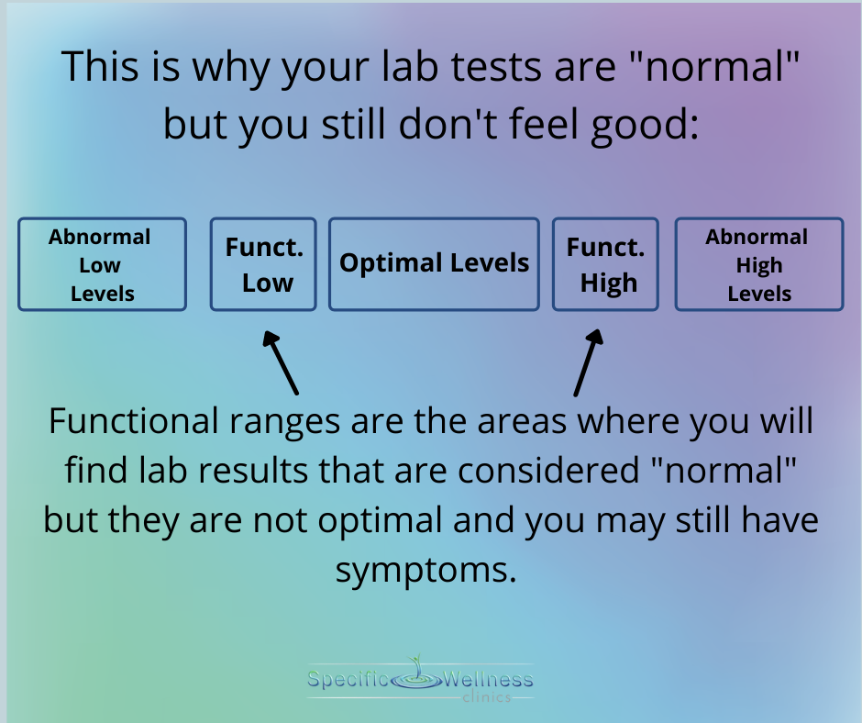
Notes:
https://drjockers.com/functional-blood-analysis/

Slide 7

Look for the Trend

Slide 8
Blood Sugar Imbalances
Iron Deficiencies
Hypothyroid
B-Vitamin Deficiencies
Inflammation and AutoImmune
Infection
Dehydration
Sleep Issues
Behavior
Most common causes of Fatigue

Slide 9

Do you have pale skin?

Slide 10
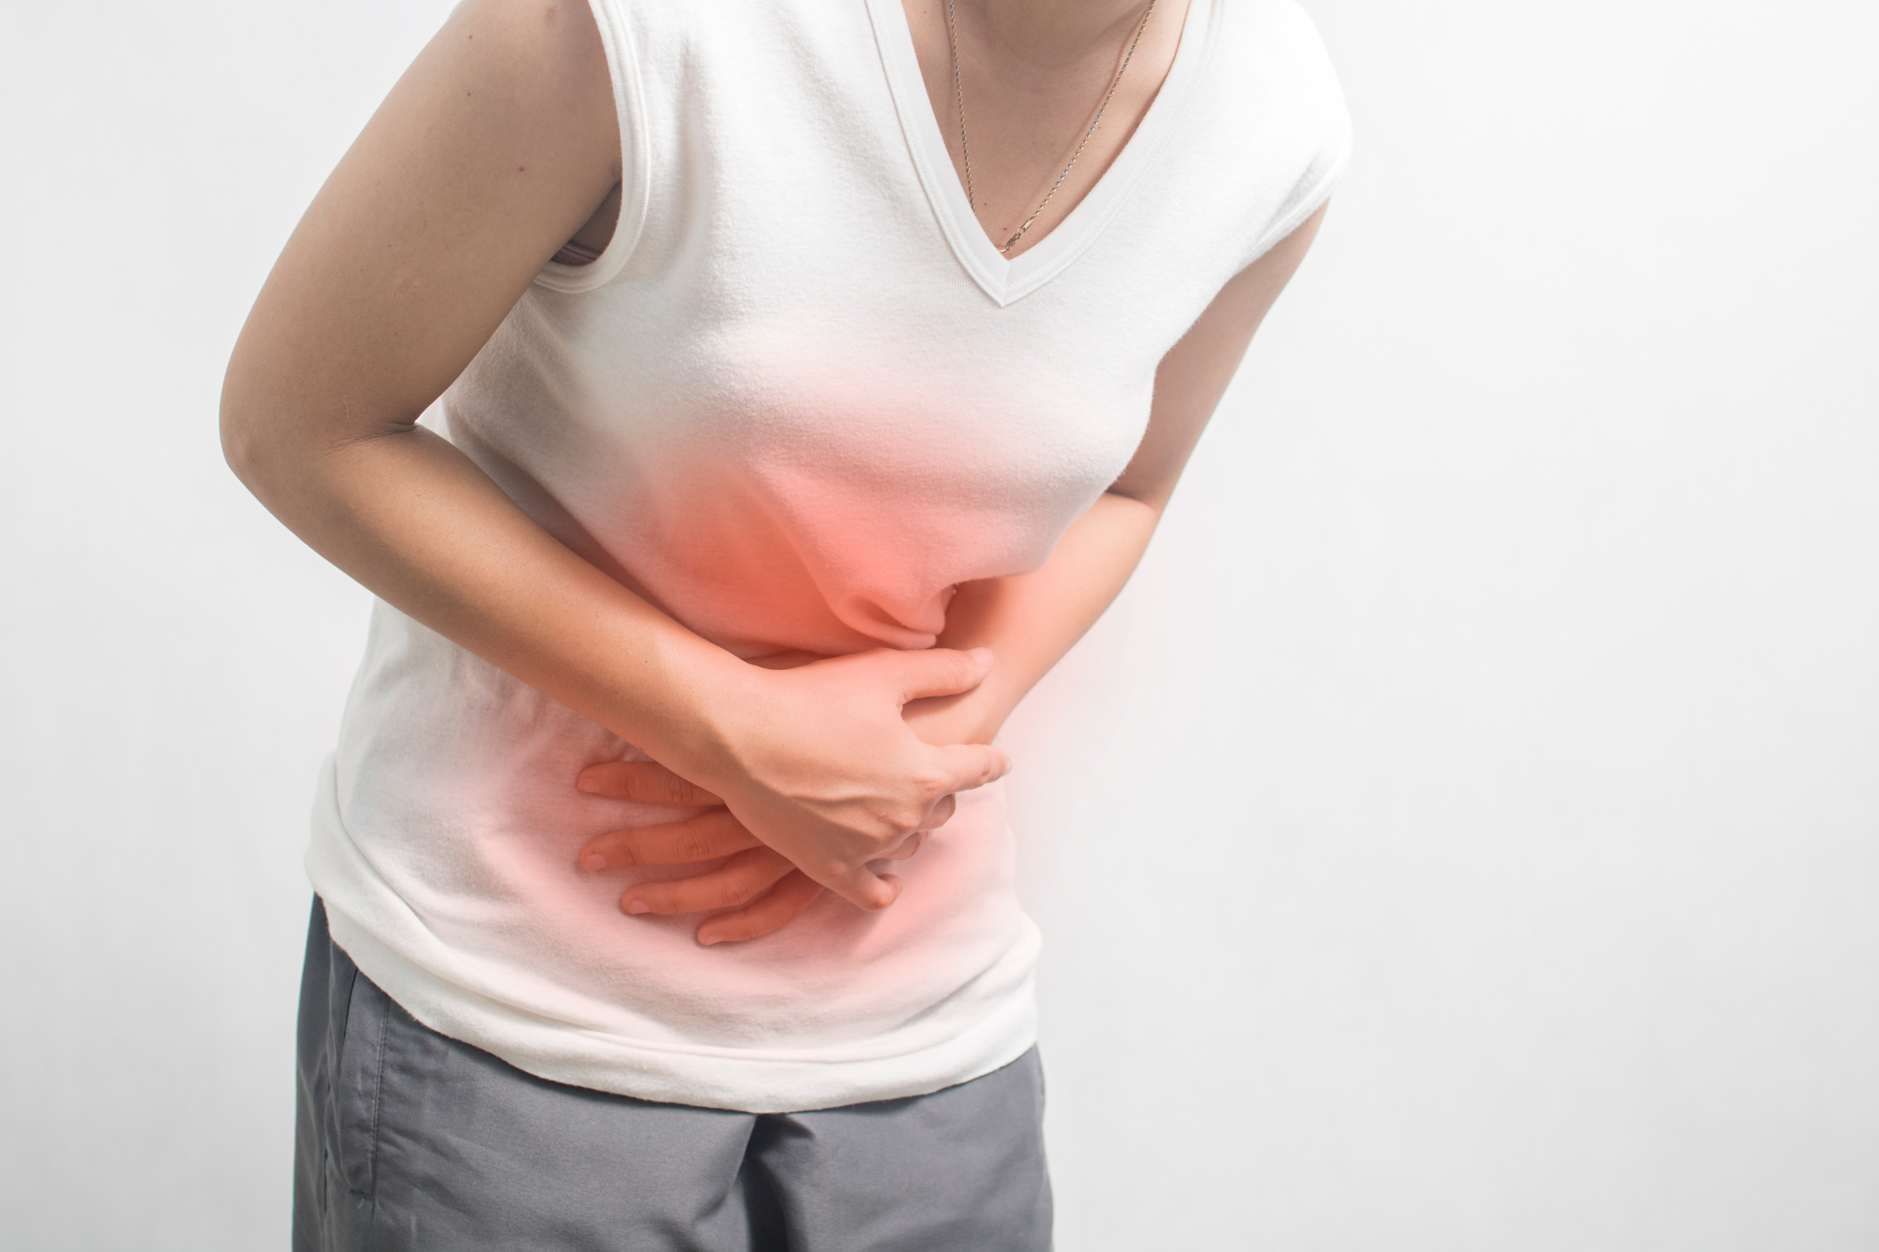
Do you have heavy periods or had blood loss due to surgery or injury in the past year?

Slide 11

Are you a vegetarian/vegan and don't regularly consume iron-rich foods or supplements?

Slide 12

Iron deficiency is the most common and treatable nutritional disorder across the world.

Slide 13

FATIGUE
WEAKNESS
PALE OR YELLOWISH SKIN
IRREGULAR HEARTBEATS
SHORTNESS OF BREATH
DIZZINESS OR LIGHTHEADEDNESS
CHEST PAIN
COLD HANDS AND FEET
HEADACHES

Slide 14
Of all the tests available to diagnose iron deficiency, SERUM FERRITN is the most able to discriminate iron deficiency from other disorders.
The current lab reference range for ferritin (acceptable at 16 or above) will lead to underdiagnosis of iron deficiency especially in women. Optimal is over 80.

Slide 15
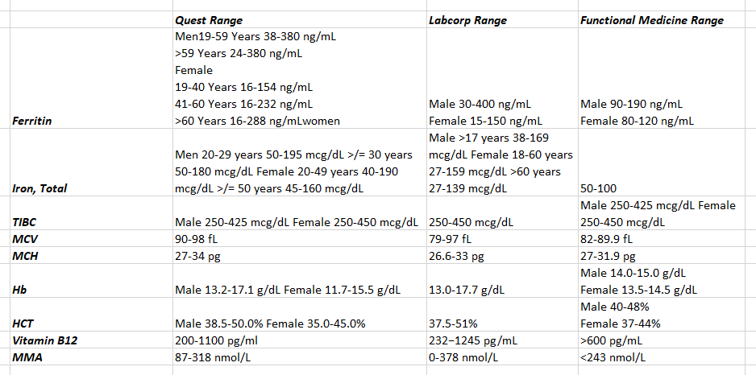

Slide 16


Slide 17

Kids with anemia cannot concentrate at school.
Konofal E, Lecendreux M, Arnulf I, Mouren M. Iron Deficiency in Children With Attention-Deficit/Hyperactivity Disorder. Arch Pediatr Adolesc Med. 2004;158(12):1113–1115. doi:10.1001/archpedi.158.12.1113

Slide 18
The mean serum ferritin levels were lower in the children with ADHD
Serum ferritin levels were abnormal (<30 ng/mL) in 84% of children with ADHD and 18% of controls while serum iron, hemoglobin and hematocrit levels were within normal ranges.
These results suggest that low iron stores contribute to ADHD and that ADHD children may benefit from iron supplementation.

Slide 19
The children with the most severe iron deficiency were the most inattentive, impulsive, and hyperactive.
This result suggests that low iron stores may explain as much as 30% of ADHD severity.

Slide 20

What would happen if these children were given iron instead of Adderall or Ritalin?

Slide 21
Iron supplementation (80 mg/day) appeared to improve ADHD symptoms in children with low serum ferritin levels suggesting a need for future investigations with larger controlled trials.
Iron therapy was well tolerated and effectiveness is comparable to stimulants.
Konofal E, Lecendreux M, Deron J, Marchand M, Cortese S, Zaïm M, Mouren MC, Arnulf I. Effects of iron supplementation on attention deficit hyperactivity disorder in children. Pediatr Neurol. 2008 Jan;38(1):20-6. doi: 10.1016/j.pediatrneurol.2007.08.014. PMID: 18054688.

Slide 22

The Problem with Grains
&
Cereal

Slide 23
Effects of iron deficiency on the CNS
(The thought processes, movements & sensations of the body)
Fatigue
Weakness
Irritability
Reduced Academic & Cognitive Performance
Reduced Memory and Focus
Depression (low serotonin)
Low Motivation & Attention (low dopamine)

Slide 24

Estrogen stimulates dopamine receptors, which helps maintain dopamine activity.
Estrogen deprivation can cause dopamine cells in the brain to die.
Lowered dopamine is made worse with iron deficiency.
Demirci K, Yildirim Baş F, Arslan B, Salman Z, Akpinar A, Demirdaş A. The Investigation of Symptoms and Diagnoses of Adult-Attention Deficit/ Hyperactivity Disorder in Women with Iron Deficiency Anemia. Noro Psikiyatr Ars. 2017 Mar;54(1):72-77. doi: 10.5152/npa.2016.12464. Epub 2016 Mar 4. PMID: 28566963; PMCID: PMC5439476.

Slide 25
Brain injuries can cause anemia, and anemia can also affect the brain

Slide 26
Brain Injury Can Cause Anemia
Severe traumatic brain injuries (TBIs) can cause a series of changes that negatively affect the body's ability to produce red blood cells, which can lead to anemia.
Anemia can also be caused by blood loss from injuries that patients have when they arrive at the hospital, or that occur during their ICU stay.
In one study, 25.7% of patients with TBIs were anemic when they were admitted, and 48% developed anemia during their ICU stay.
https://www.ncbi.nlm.nih.gov/pmc/articles/PMC4911680/

Slide 27
Anemia Can Affect the Brain
Anemia can deprive the brain of oxygen, which is vital for its function.
Anemia makes it difficult to concentrate because of the reduced oxygen supply to the brain.
Some studies have found that low hemoglobin levels may be associated with worse outcomes, especially for patients with compromised brain tissue oxygen tension.
Anemia negatively affects recovery from traumatic brain injuries
https://www.sciencedaily.com/releases/2016/05/160525121227.htm

Slide 28

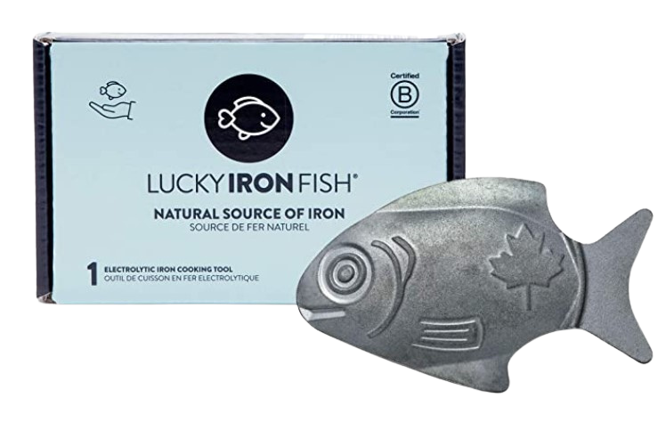
Dr Christopher Charles

Slide 29




Another form of Anemia
Homocysteine
Folic Acid
(Synthetic B9)
Folate (Methylated B9)

Slide 30
44% Reduction in suicide attempts!!
Association Between Folic Acid Prescription Fills and Suicide Attempts and Intentional Self-harm Among Privately Insured US Adults
Robert D Gibbons 1, Kwan Hur 1, Jill E Lavigne 2 3, J John Mann 4
Affiliations expand
PMID: 36169979 DOI: 10.1001/jamapsychiatry.2022.2990

Slide 31
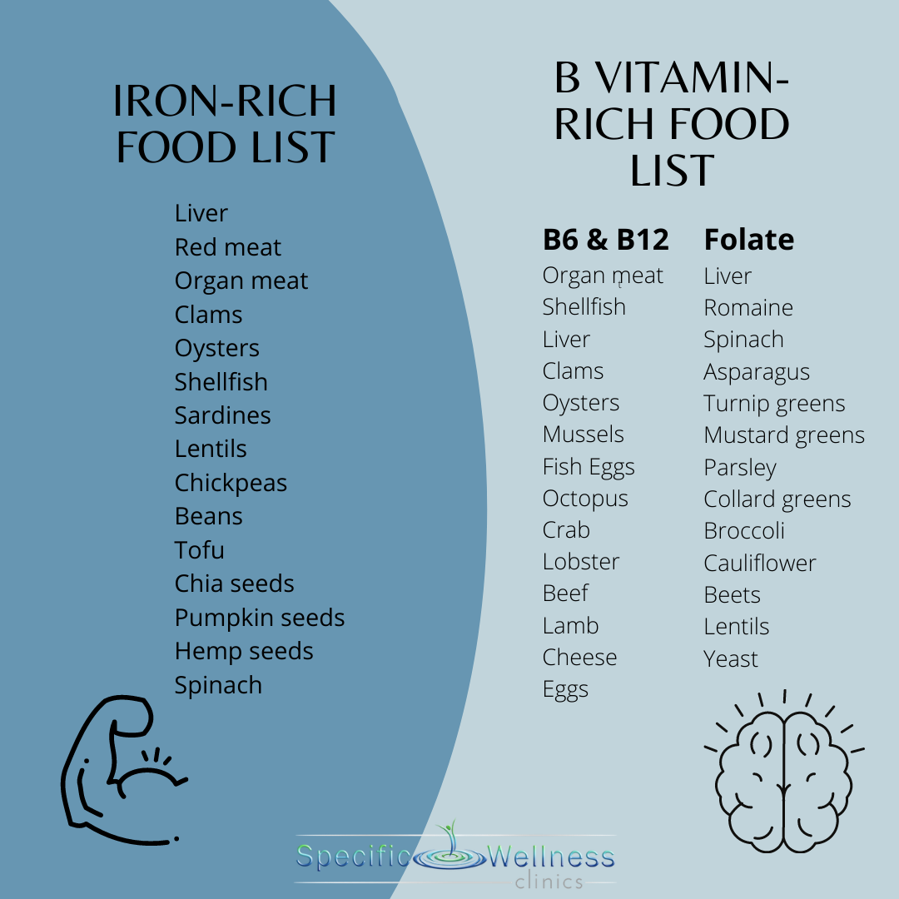
Step 1:
Get your Ferritin & Homocysteine Levels checked
Step 2:
Eat foods rich in Iron and B Vitamins

Slide 32

Do you often feel cold, especially in your hands and feet?

Slide 33

Have you experienced dry skin, brittle nails or hair loss?

Slide 34
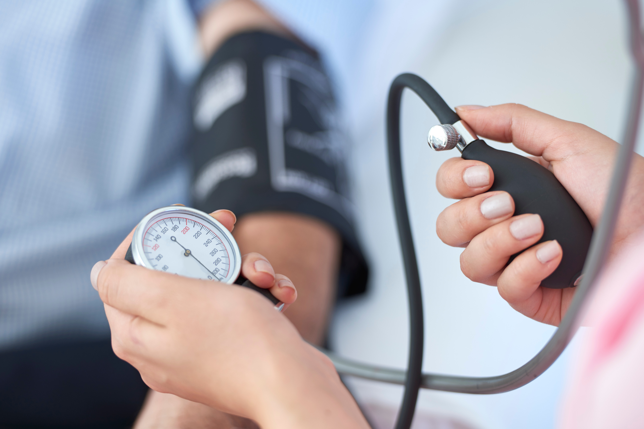
Do you have low blood pressure and
low body temperature?

Slide 35

The thyroid gland is part of the endocrine system and regulates body temperature, metabolism, weight, muscle strength and mood.

Slide 36

FATIGUE
FEELING COLD
WEIGHT GAIN
CONSTIPATION
DEPRESSION
SLOW THOUGHTS
MUSCLE WEAKNESS
DRY SKIN
BRITTLE HAIR AND NAILS
LOSS OF LIBIDO (SEX DRIVE)

Slide 37

TIRED BUT WIRED
NERVOUSNESS
ANXIETY
IRRITABILITY
MOOD SWINGS
SWEATING
FAST HEARTBEAT
INSOMNIA
WEIGHT LOSS

Slide 38
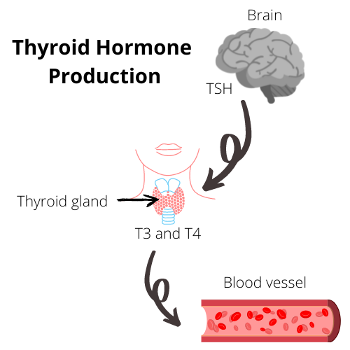

Slide 39
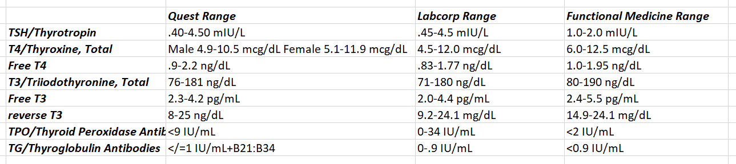

Slide 40
Thyroid Function Tests
TSH & T4 levels
TSH lab range is 0.4–4.5 mIU/L Optimal Range is 1-2mIU/L
Subclinical hypothyroidism is when TSH levels are elevated and T4 levels are normal.
Thyroid peroxidase antibody (TPO) test: High levels of TPO antibodies may indicate Hashimoto's thyroiditis.
TPO lab range is 0-34IU/mL Optimal range is under 2 IU/mL

Slide 41
Hashimoto's thyroiditis is an autoimmune disease that's the most common cause of subclinical hypothyroidism, accounting for 60–80% of cases.

Slide 42



T4 T3
Brain injury is associated with reduced conversion of T4 to T3 resulting in inflammation, altered metabolism, and destruction of neurons.
https://www.ncbi.nlm.nih.gov/pmc/articles/PMC5962384/#:~:text=Brain%20injury%20is%20associated%20with,altered%20metabolism%2C%20and%20neuronal%20death.

Slide 43

A large number of studies show that intestinal dysbiosis, bacterial overgrowth and increased intestinal permeability (intestinal leakage) contribute to the development of Hashimoto’s
Zhu X, Zhang C, Feng S, He R, Zhang S. Intestinal microbiota regulates the gut-thyroid axis: the new dawn of improving Hashimoto thyroiditis. Clin Exp Med. 2024 Feb 22;24(1):39. doi: 10.1007/s10238-024-01304-4. PMID: 38386169; PMCID: PMC10884059.

Slide 44

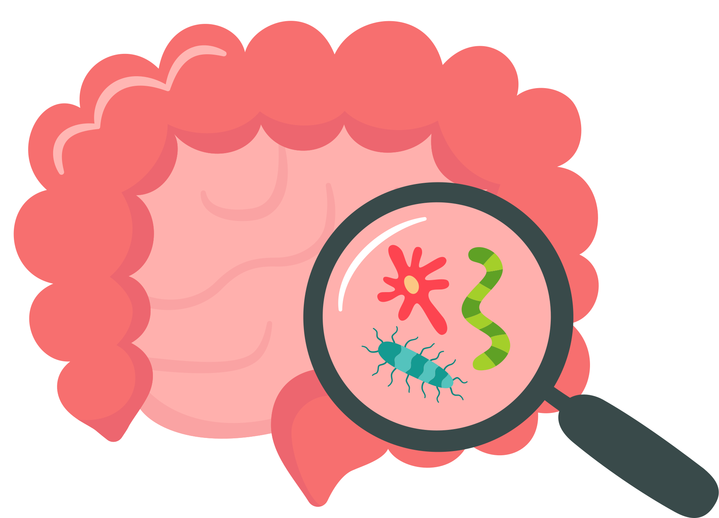
Leaky Gut
Autoimmunity
Hashimotos or Graves Disease

Slide 45

5 Most Common Endocrine Disruptors to the Thyroid
  Flame Retardants (upolstered furniture)
  PCBs (Seafood. Eat SMASH)
  Phthalates & Parabens (Perfumes and Fragrences)
  BPAs (Plastics)
  Perfluorinated Chemicals aka PFOAs (non stick pans and cooking sheets)
  Glyphosate

Slide 46
Perfumes
Makeup
Nail polish
Air fresheners
Shower curtains
Plastic food containers
Kids toys
Scented candles
More Phthalates

Slide 47
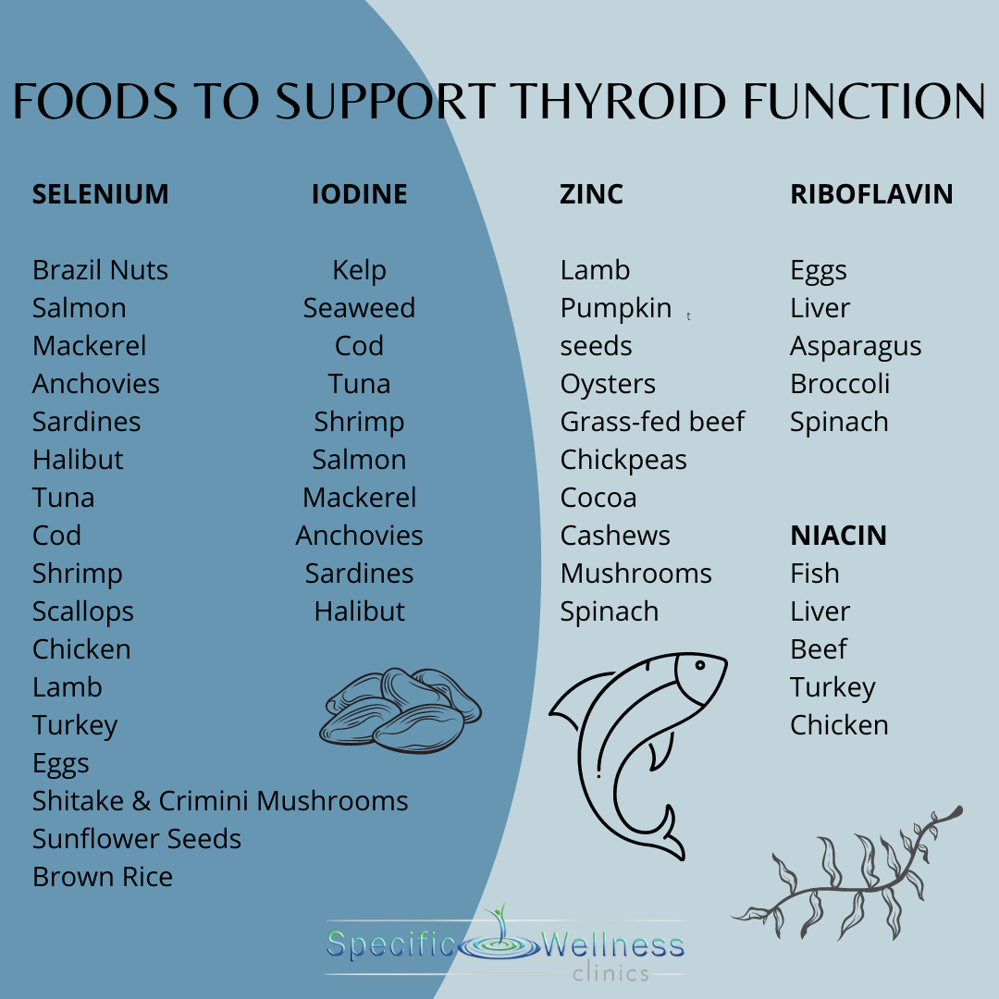

Slide 48

Do you experience sudden energy crashes, especially after meals?

Slide 49

Do you crave sugary or carbohydrate-rich foods throughout the day?

Slide 50

Do you feel shaky, irritable, head-achey, “hangry” or lightheaded if you miss a meal?

Slide 51

BLOOD SUGAR
Notes:
https://drjockers.com/hypoglycemia-natural-solutions/
https://drjockers.com/diabetes/

Slide 52
Signs & Symptoms of Blood Sugar Imbalance
FATIGUE
HUNGER
TINGLING LIPS
BECOMING EASILY IRRITATED, TEARFUL, ANXIOUS OR MOODY
INCREASED THIRST
HEADACHES
RECURRENT INFECTIONS
TROUBLE CONCENTRATING

Slide 53
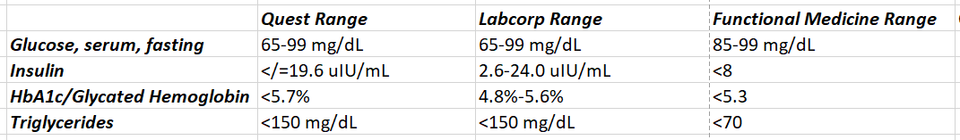

Slide 54
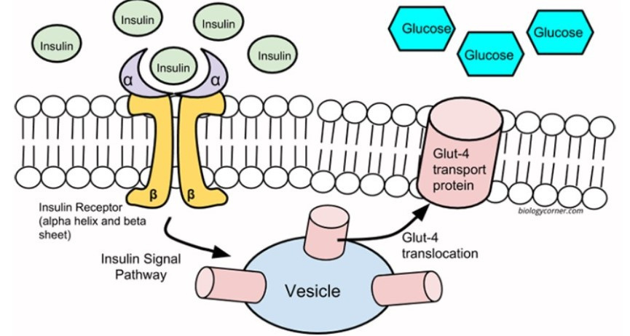

Slide 55

When your blood sugar drops too low it puts a lot of stress on your brain.
Your brain uses 20% of all the energy your body makes; it requires more energy (blood sugar) than any other organ in your body.
It is also the first organ to suffer when blood sugar drops.

Slide 56

After a brain injury, the body releases stress hormones to help fight off infections and other problems. These hormones make the body less sensitive to insulin which can cause blood sugar levels to rise. If the levels go up too high, the patient can become hyperglycemic.
https://www.ncbi.nlm.nih.gov/pmc/articles/PMC5342608/

Slide 57
High Insulin
Increases testosterone in women
Increases estrogen in men
Increases cholesterol
Increases blood pressure
Increases oxidative stress
Decreases detoxification

Slide 58
Origins of a Ketogenic Diet
The ketogenic diet was first used in 1921 by Dr. Russell Wilder at the Mayo Clinic to treat epilepsy in patients and found it to be as effective as fasting in treating epilepsy.

Slide 59
Approximately 30% of children who develop epilepsy will develop seizures unresponsive to medication or experience intolerable side effects from antiseizure medications.

Slide 60
A 2006 meta-analysis of 19 observational studies (1084 patients) found that after six months of initiating a ketogenic diet:
60% of children had a greater than 50% seizure reduction
30% had greater than 90% seizure reduction
https://www.ncbi.nlm.nih.gov/pmc/articles/PMC3434405/

Slide 61
4 Step
“No Hunger or Deprivation” weight loss and energy program

Slide 62

  Balance your blood sugar
  Support your thyroid
  Avoid anemias
  Reduce inflammation
Without Hunger
or
Deprivation

Slide 63
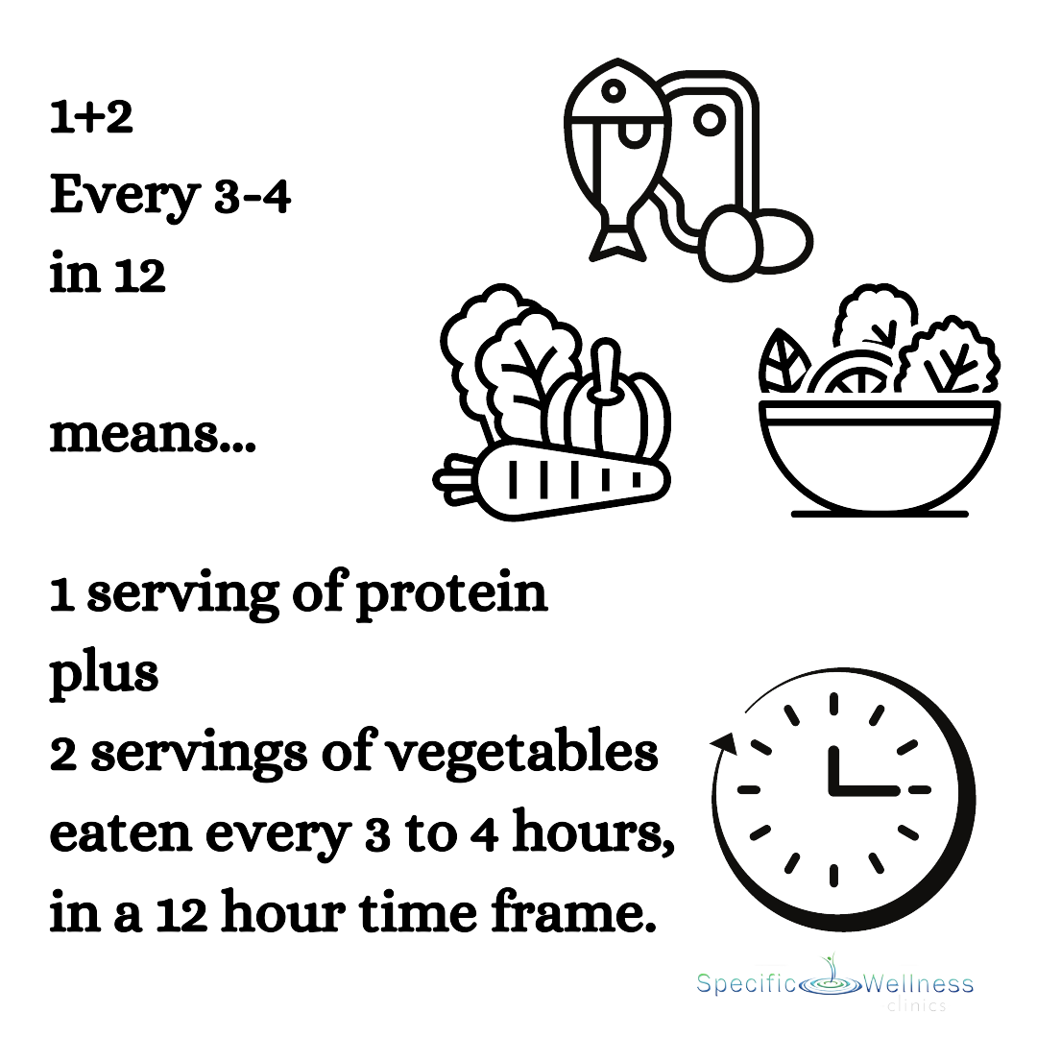

Slide 64
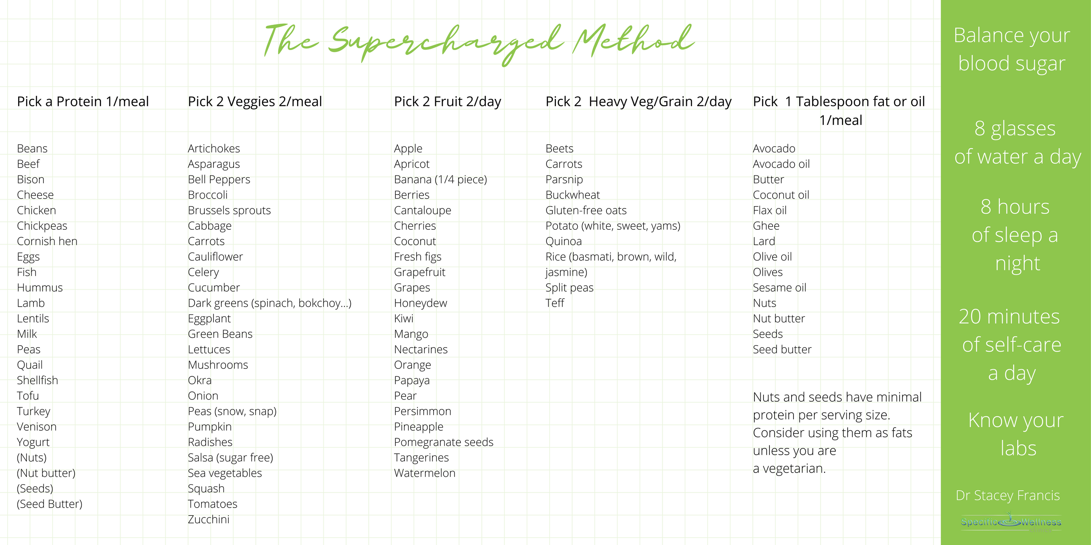



Slide 65
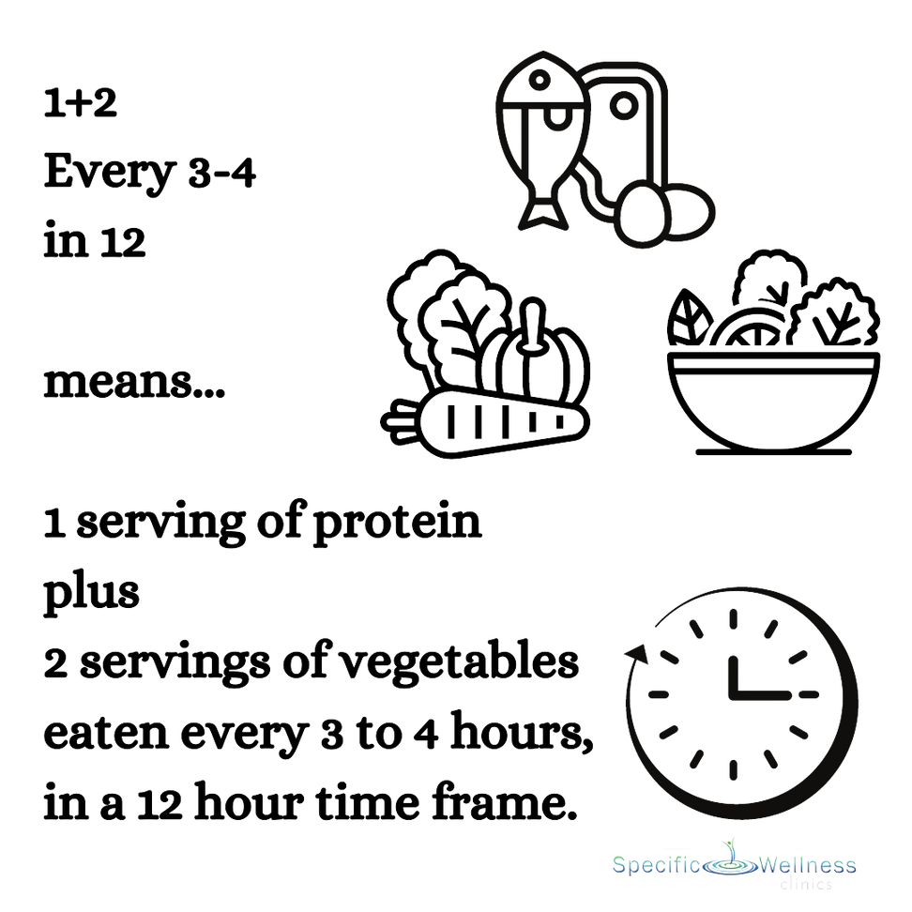
Meal 1
Meal 2
Meal 3
Meal 4

Slide 66


Slide 67
“The goal is to turn data into information, and information into insight.” —Carly Fiorina

Slide 68



www.SpecificWellness.com
For Slides:
info@SpecificWellness.com

